Slide 1
COSMOS: Cluster #11 Intro to Autonomous Vehicles
Introduction to OpenCV Python
Moises Lopez
ECE Grad Student

Slide 2
Requirements
From First steps with DepthAI — DepthAI documentation | Luxonis
MacOS
bash -c "$(curl -fL https://docs.luxonis.com/install_depthai.sh)"
Windows
Use installer: https://github.com/luxonis/depthai/releases/download/v3.4.0/DepthAI-setup-v3.4.0.exe
Linux
sudo wget -qO- https://docs.luxonis.com/install_depthai.sh | bash

Slide 3
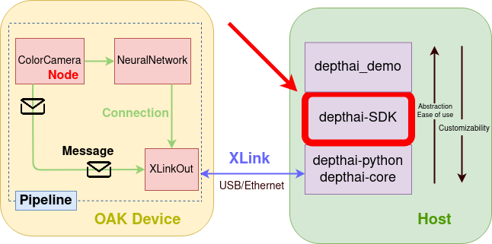
From: DepthAI API Documentation — DepthAI documentation | Luxonis

Slide 4
Installation
DepthAI SDK is available on PyPI. You can install it with the following command:
# Linux, MacOS, and Windows
python3 -m pip install depthai-sdk

Slide 5
Seeker Demo
UCSD | MAE 148 Seeker Demo Team 1 Winter22 - YouTube

